Slide 1
3D MESH COMPRESSION AND TRANSMISSION FOR MOBILE ROBOTIC APPLICATIONS Bailin Yang , Xun Wang, Frederick W.B. Li, Binbo Xie, Xiaohui Liang and Zhaoyi Jiang
PRESENTED BY
Shahaf Zohar - 205978000
Roey Salah - 206115438 Dean Elimelech - 206323206

Slide 2
Outline
Motivation
Problem
3D representations
Large data sizes
Related work
Related work - Mesh Transmission
Related work - Mesh Compression
Method overview
Article’s method
Mesh Quality
Mesh Compression through Quantizing the Laplacian Transformation
Mesh Transmission Workflow
Mesh Quality Control: VDE and LFE
Results
Discussion
Pros and Cons
Future Work

Slide 3
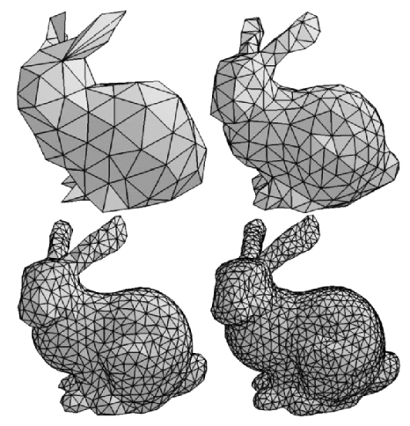

Motivation
Mobile robots require 3D environment models for accurate motion planning and navigation.
The paper develops a new quality-driven mesh compression method without needing priori mesh structures.
This allows efficient and adjustable mesh transmission to match robotic applications with dynamic environments.

Slide 4

Problem
The problem with 3D mapping in mobile robotic applications is the inefficiency in transmitting 3D representations due to the requirement of constructing structures on top of 3D meshes before transmission. This dependency on a-priori structures can be challenging for dynamically generated or updated environments during runtime, especially in real-time robotic applications where environment representations are incrementally built and updated as the robot explores.

Slide 5
Problem - Mesh 3D Representations
Mesh 3D representations in the context of mobile robotic applications face challenges due to the large data sizes of meshes, impacting the efficiency of transmitting environment and object representations for tasks such as 3D mapping and motion planning.

Slide 6
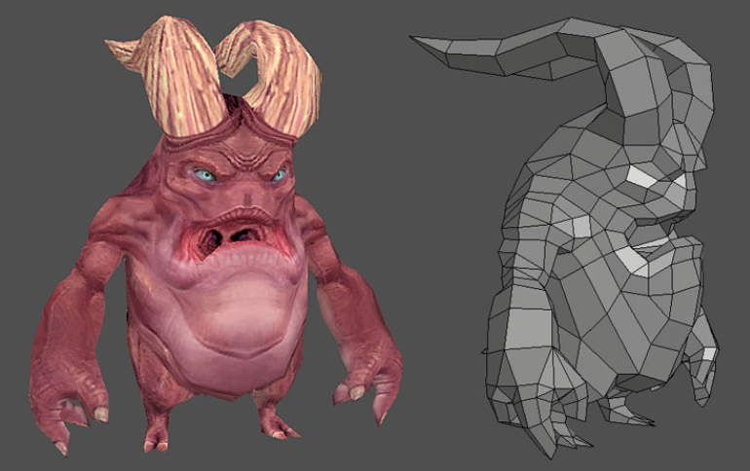
Problem – Large data sizes Representations
These 3D mesh models often involve large data sizes. Transmitting these large mesh models to different system modules causes delays and performance issues

Slide 7
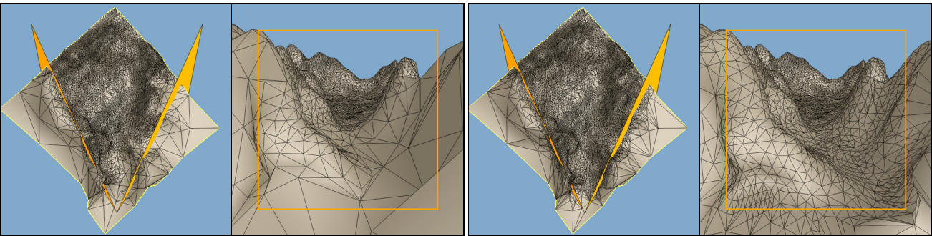
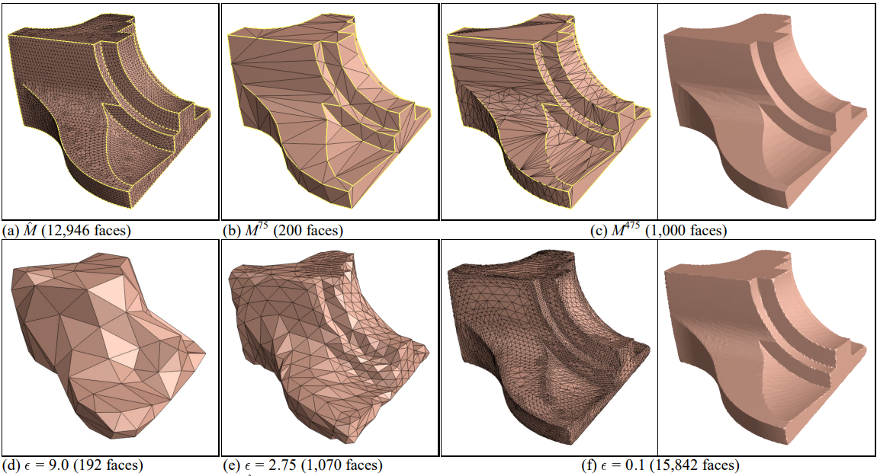
Related work - Mesh Transmission
Traditional mesh compression methods like progressive meshes hinder real-time robotic applications due to pre-built mesh structures.
3D mesh specific data transmission protocols

Slide 8
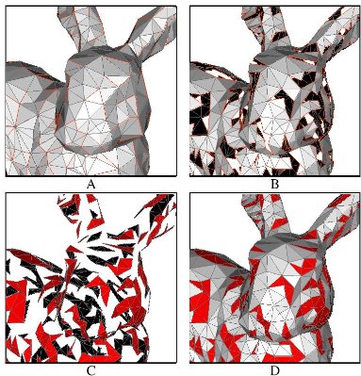
Related work - Mesh Compression
Compressing mesh geometry
Vertex quantization
Cluster-based random accessible compression scheme

Slide 9
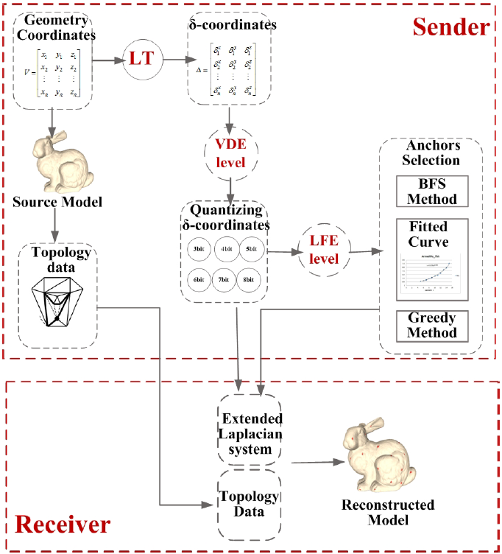
Method overview
Transmission connectivity information (topology data)
Compress geometric coordinates
Laplacian transformation
Visual Distortion Error (VDE)
Low-Frequency Error (LFE)

Slide 10
ARTICLE’S METHOD
Mesh Quality
Mesh Compression through Quantizing the Laplacian
Transformation
Mesh Transmission Workflow

Slide 11
Mesh Quality
Compressing mesh vertices by quantizing their Laplacian transformation while adjusting
Visual Distortion Error (VDE)
Low-Frequency Error (LFE) to control quality
The mesh quality relates
mesh quantization
distribution anchors
mesh quality focuses on global and local geometric errors,

Slide 12
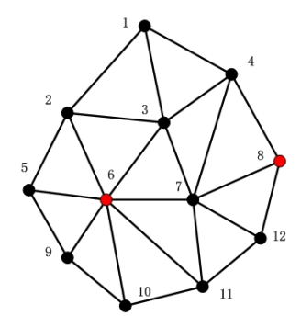
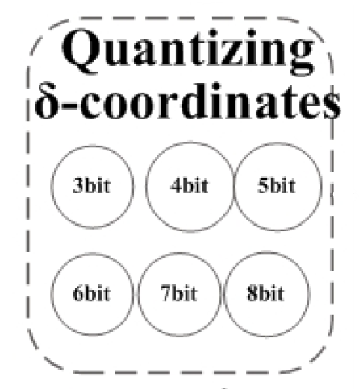
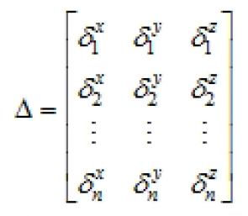
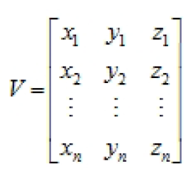
Mesh Compression through Quantizing the Laplacian Transformation
1. Laplacian transformation
2. Quantization
3. Adding Anchors (Mark in red)

Slide 13


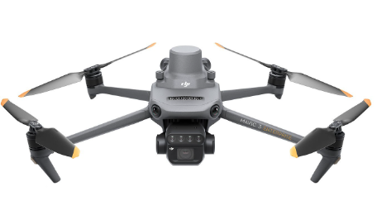
Mesh Transmission Workflow
Laplacian transformation
Quantize δ coordinates
Algorithm
Anchors based on LFE level
Improve LFE by Greedy method
Sender
Send δ coordinates and anchor's
Receiver

Slide 14
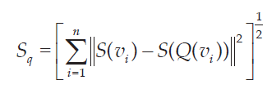
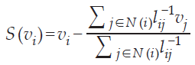
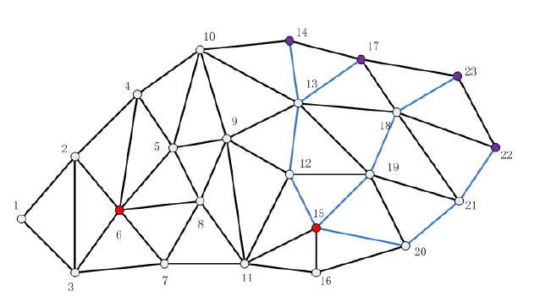
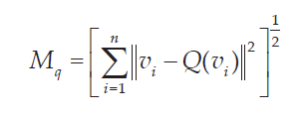
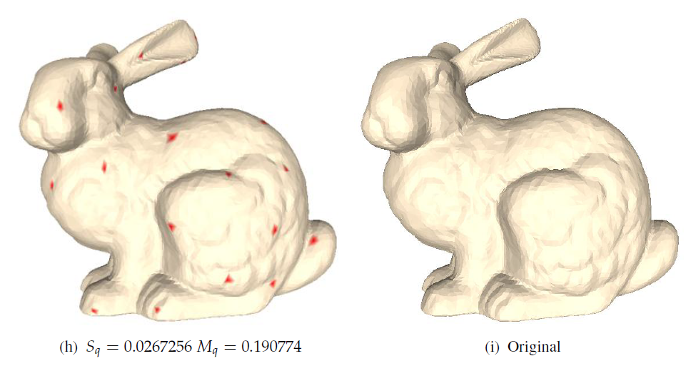
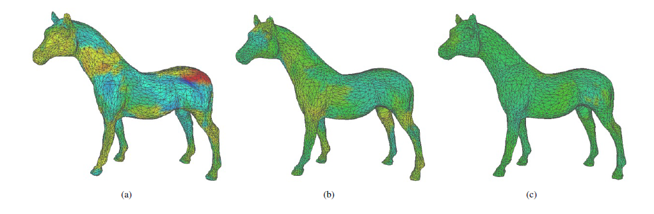
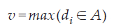
Mesh Quality Control: VDE and LFE
VDE - Visual Distortion Error (Sq)
LFE - Low-frequency error (Mq)
BFS

Slide 15
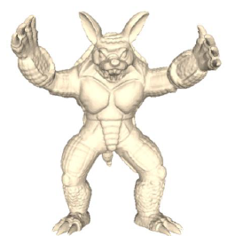
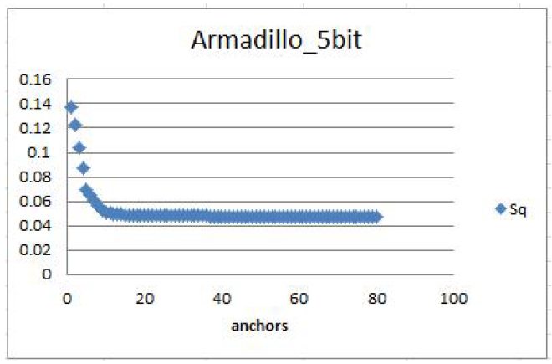
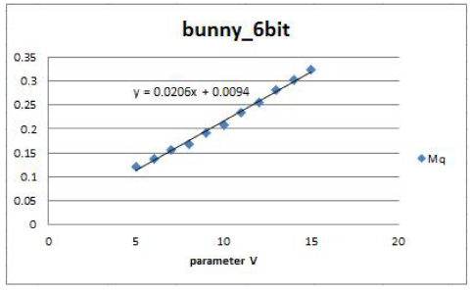
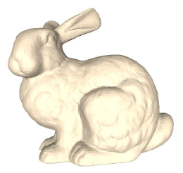
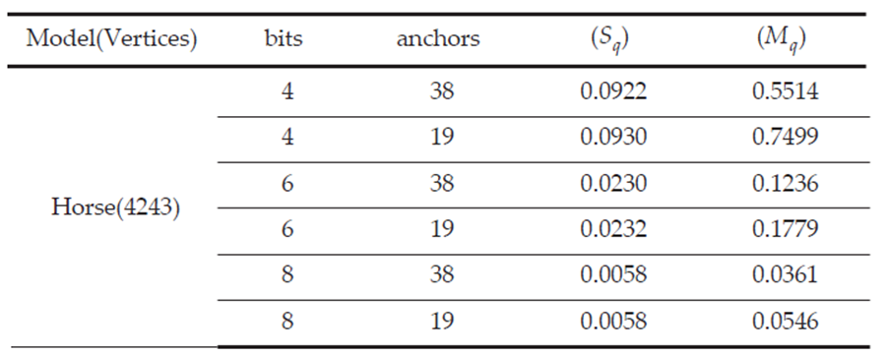
RESULTS
Add Anchors vs. VDE
Parameter V vs. LFE
Horse model:

Slide 16

Discussion
Mq
Sq
Quantize δ coordinates
Adding Anchors

Slide 17
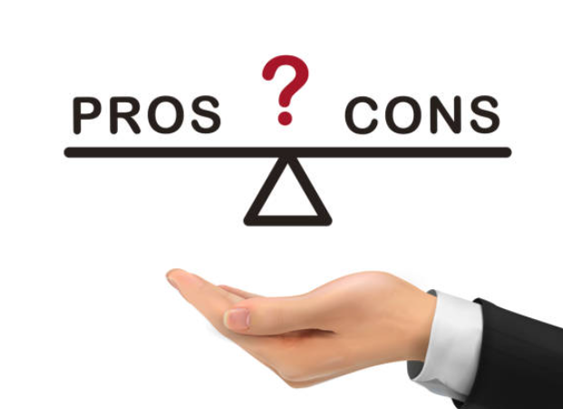
Pros and Cons
Pros:
Efficient compression without a priori structures.
Quality control through adjustment of error metrics.
Flexibility in transmitting entire mesh or specific parts.
Cons:
Increased complexity in implementing quantization.
Balancing compression ratios with visual quality.
Potential resource overheads in dynamic parameter adjustments.

Slide 18

Future Work
Explore advanced quantization techniques to further optimize mesh.
Investigate the integration of machine learning algorithms for adaptive
Develop real-time monitoring systems to dynamically adjust mesh transmission

Slide 19

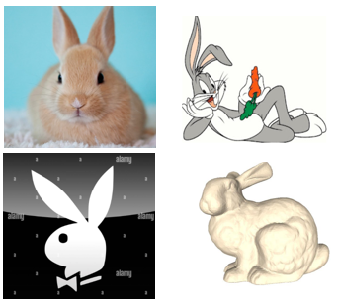
THANK you

